Slide 1

Exploring Time Series Classification Techniques for ECG Data: Capturing Feature Dependencies for Reliable Diagnosis
Viveka Salinamakki

Slide 2
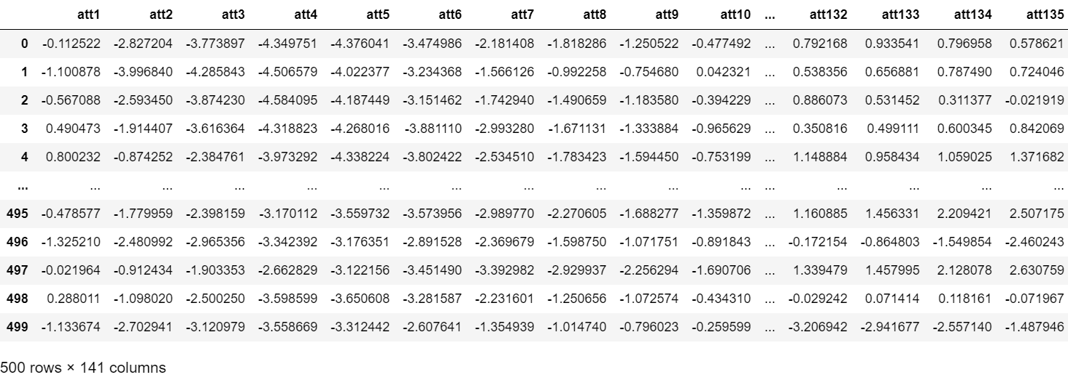
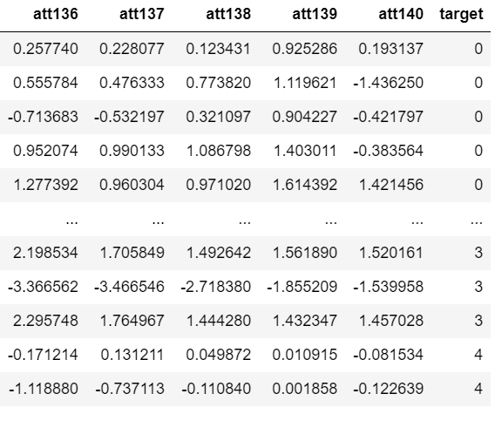
About the Dataset

Slide 3
Data preprocessing
Converted labels from {b'1', b'2', b'3', b'4', b'5’} to {0, 1, 2, 3, 4}
Check if the values are missing

Slide 4
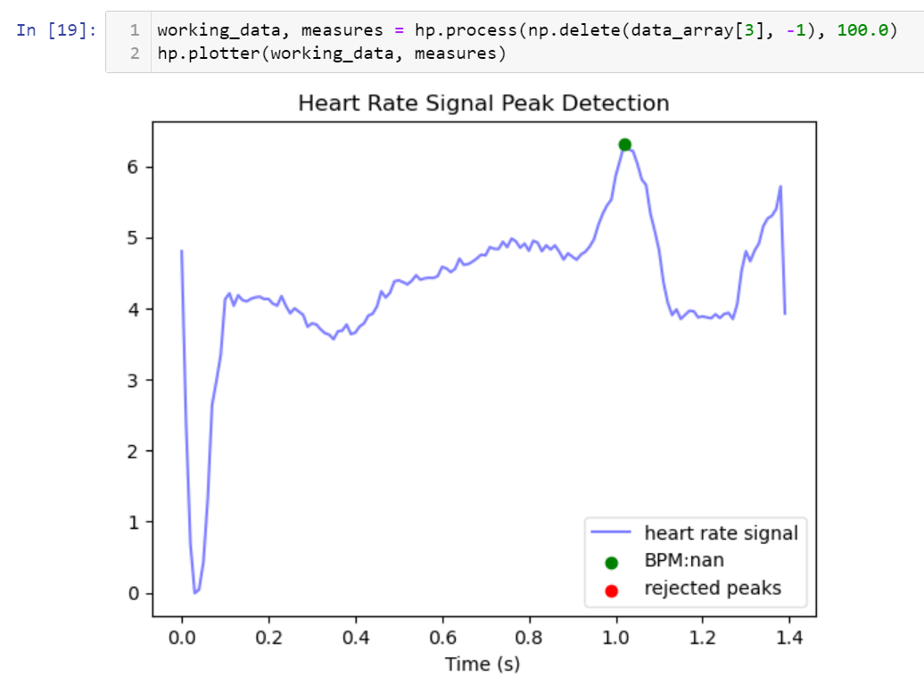
ECG signal data

Slide 5

Challenges for a time series dataset
The features are correlated but Machine Learning algorithms consider features to be independent
So, shuffling the features do not make a difference

Slide 6

Using PCA for dimension reduction and logistic regression for predcition

Slide 7
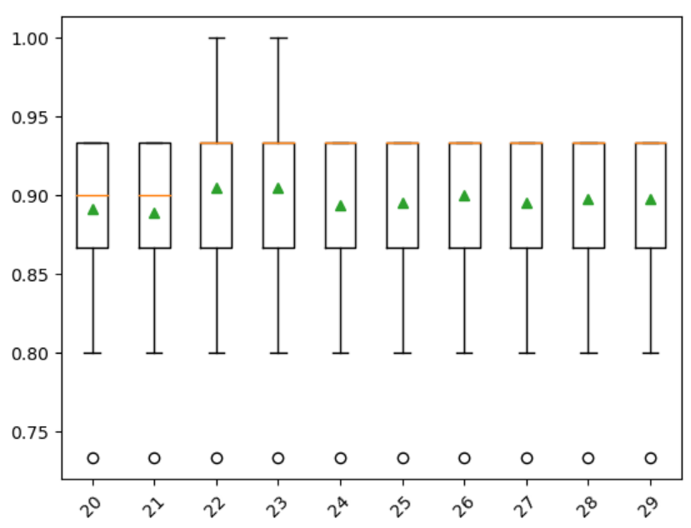
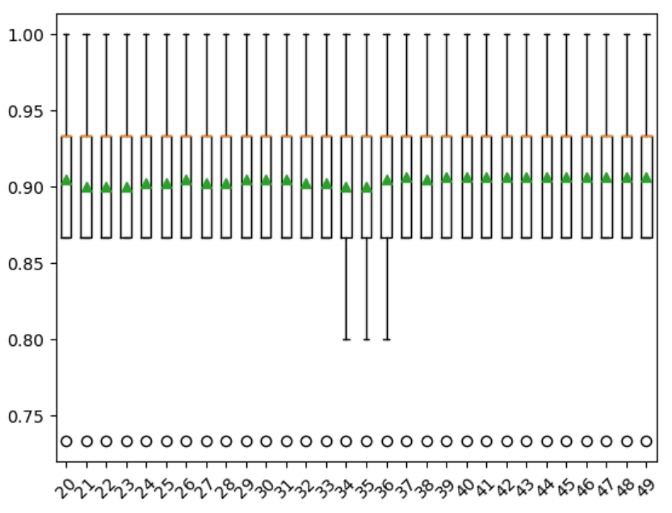
Accuracy scores for Unshuffled and Shuffled data

Slide 8
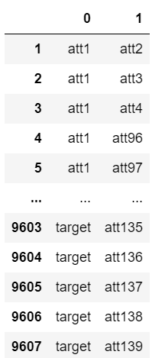
Why is dependency important for time series datasets?
Values at the current time stamp depend on the value at the previous stamp
Intuition backed by the table which shows the features with |correlation|>0.3

Slide 9

The neural network approach

Slide 10
Recurrent neural networks
Feed forward give the outputs of each layer to the next layer
CNN suitable for spatial data (image and video) and it is suitable for capturing local patterns and not dependencies that exist between time-varying variables
RNN has a memory component and is so more suitable for sequential data as it captures these temporal dependencies
This makes it suitable for sequential data such as NLP, time series and so on
Standard RNN has the “Vanishing Gradient Problem”
There are two kinds in RNN
Long Short Term Memory (LSTM)
Gated Recurrent Unit (GRU)

Slide 11
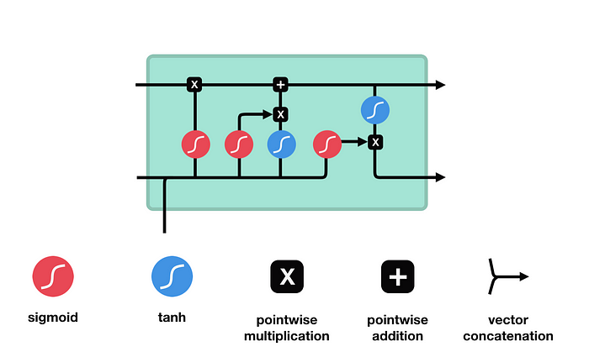
LSTM
There 3 components for LSTM and a cell state:
Forget Gate: Decides what is relevant to keep from prior steps
Input Gate: Decides what information is relevant to add from the current step
Output Gate: Determines what the next hidden state should be
Bagging is included with the usage of dropout probabilities
Image Credits

Slide 12
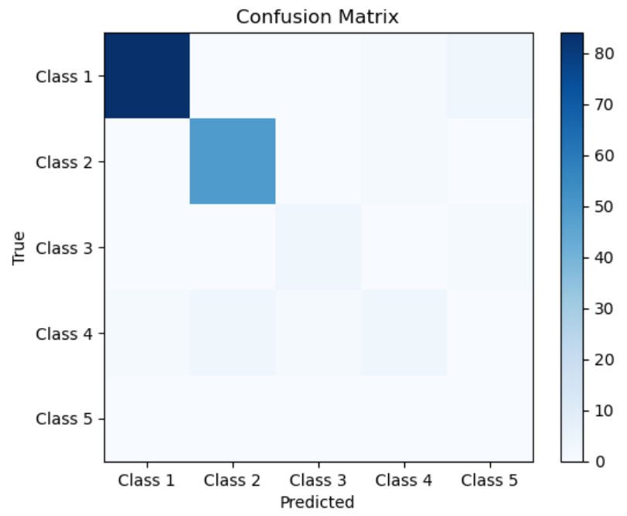
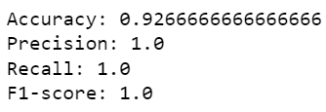
LSTM Results for unshuffled data

Slide 13
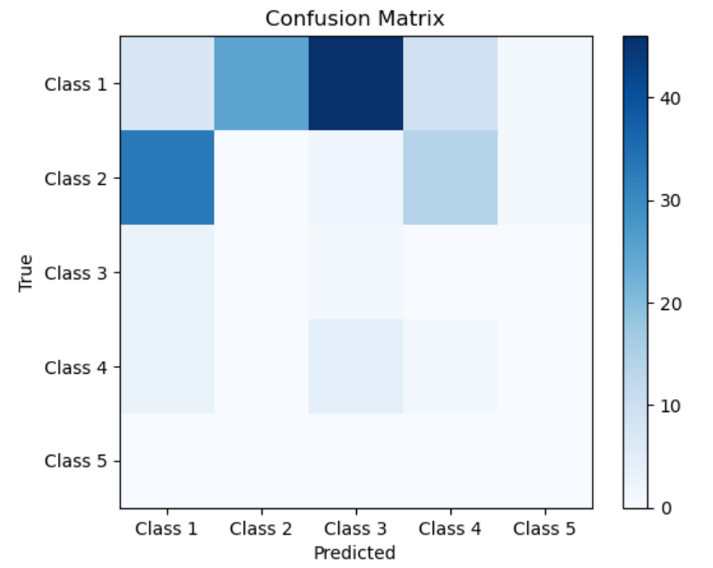
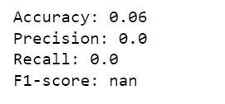
LSTM Results for shuffled data

Slide 14
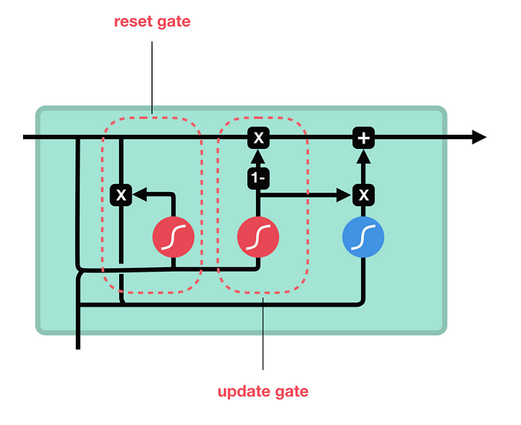
GRU
There are 2 components in GRU
Update Gate: Similar to the forget and input gate of an LSTM
Reset Gate: Similar to the reset gate in LSTM
Bagging is included with the usage of dropout probabilities
Image Credits

Slide 15
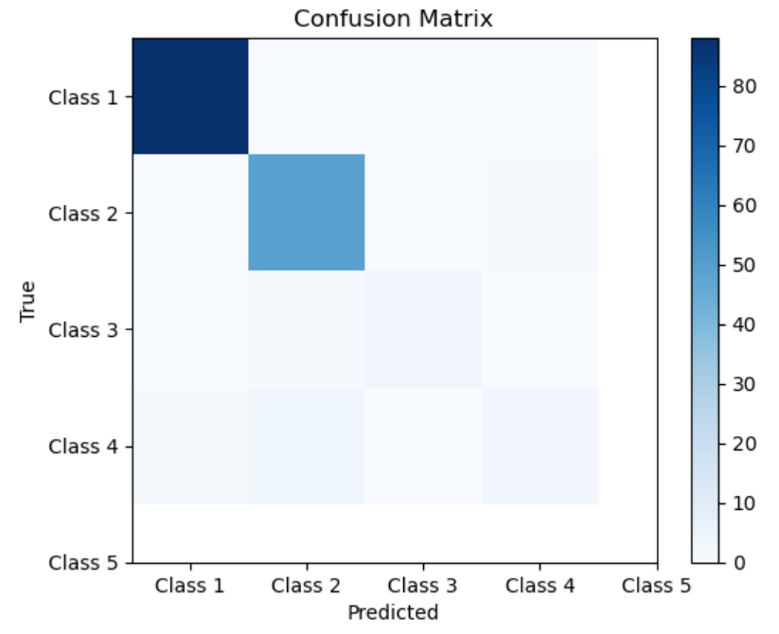
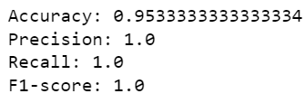
GRU Results for unshuffled data

Slide 16
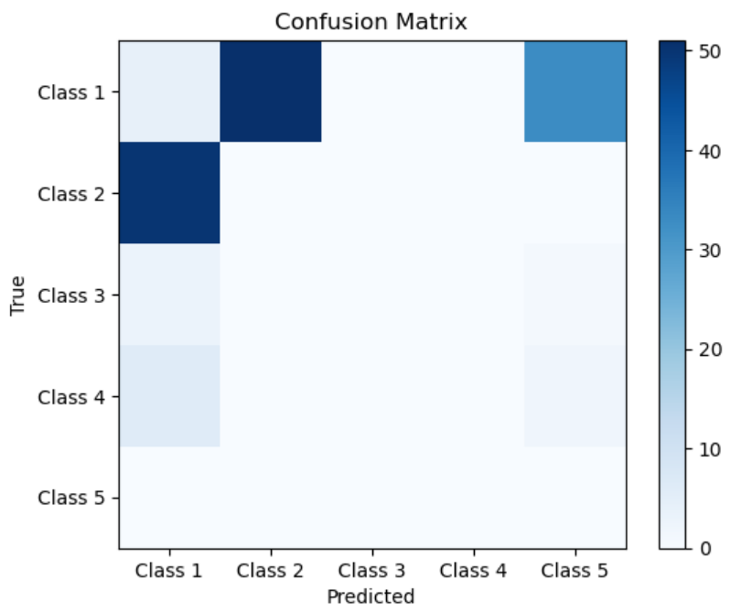
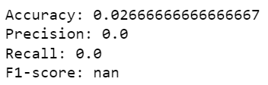
GRU Results for shuffled data

Slide 17
LSTM vs GRU
GRU is faster due to the presence of 2 gates compared to 3 in LSTM
Due to the absence of a memory, GRU may encounter the vanishing gradient for long term dependencies
LSTM has a memory component which makes it suitable for long time series
Both performed similar to each other, and I would prefer LSTM for the memory

Slide 18
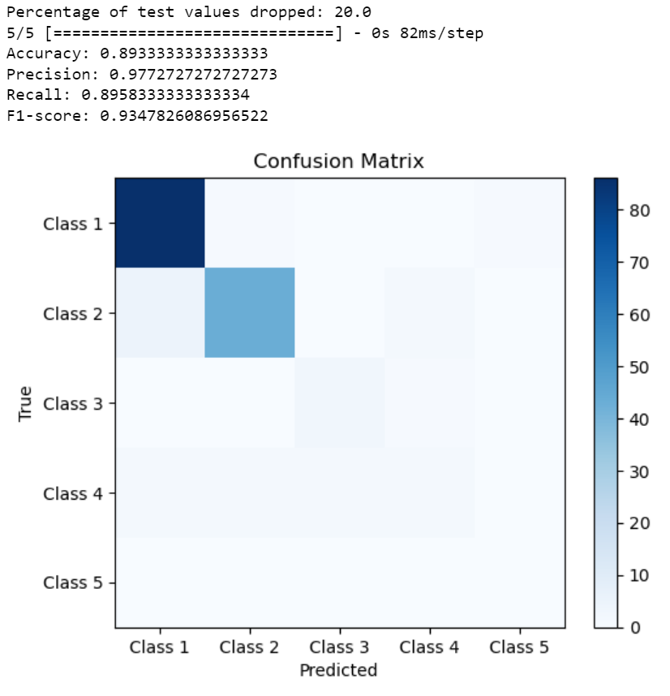
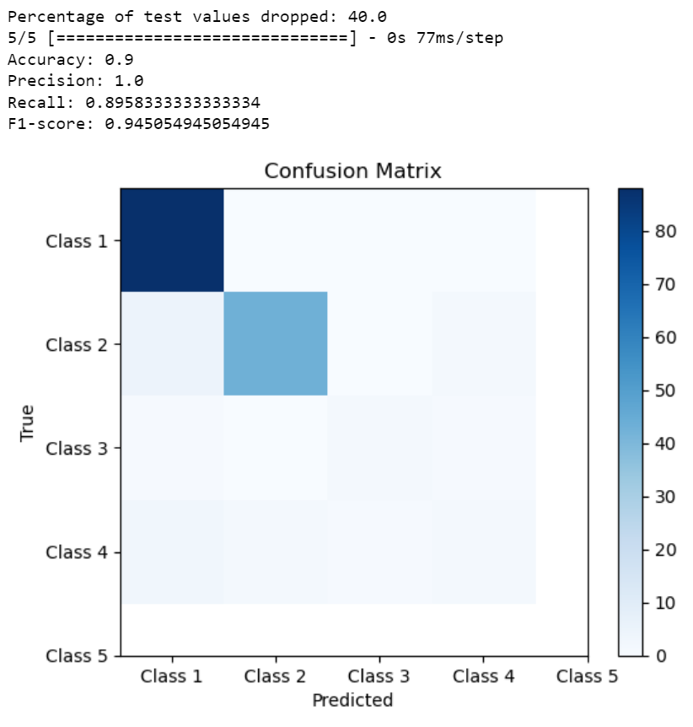
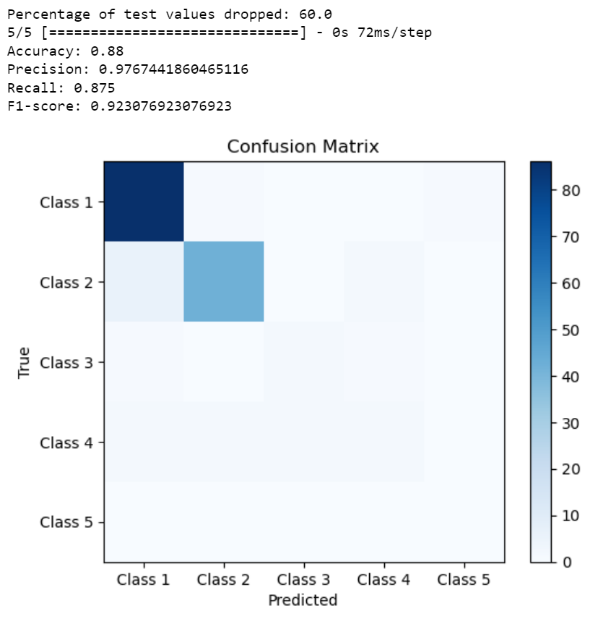
Robustness of LSTM
The Robustness of LSTM was tested by dropping a fraction of random values in the test dataset

Slide 19
Other Unsuccessful Approaches
Random Forest Classifier
Dynamic Time Warping SVM (DTW-SVM)
Support Vector Data Description for Time Series (SVDD-TS)

Slide 20
Other Approaches to Explore
Transfer Learning

Slide 21

Thank you

